Slide 1

School Bus Operator Training & Certification Program
West Virginia Department of Education &
Southern Educational Services Cooperative

Slide 2

  WVDE – Office of School Facilities
  & Transportation
Tommy Young, Executive Director
Sherry Sadler, Program Assistant
Victor Gabriel, WV School Bus Operator Training and Testing Coordinator
School Bus Inspectors
  Dave Baber
  Ray Dickens
  Dave Moore
  Wesley Stone
  Darrin Younker
Southern Educational Services Cooperative
  Paula Hamilton
  Charles Phillips

Slide 3

Icebreakers: Questions to pick your brain.
All paperwork must be within a six month time frame. True or False
On the physical, what are the maximum numbers for B/P?
What needs to occur if a criminal background is disclosed on the FBI check?
A DMV record needs a lookback of what period of time?
What is the minimum number of hours for classroom training?
For behind the wheel training?
All medical examiners used by our program must be on what list?
Do you know who your bus inspector is?
What wording should not appear on the alcohol test, but should be on the drug test?
Notes:
Classroom training and/or BTW do not have to be within certain dates – does not expire. Certification test must be given to new applicants within 6 mos.
140/90

Slide 4
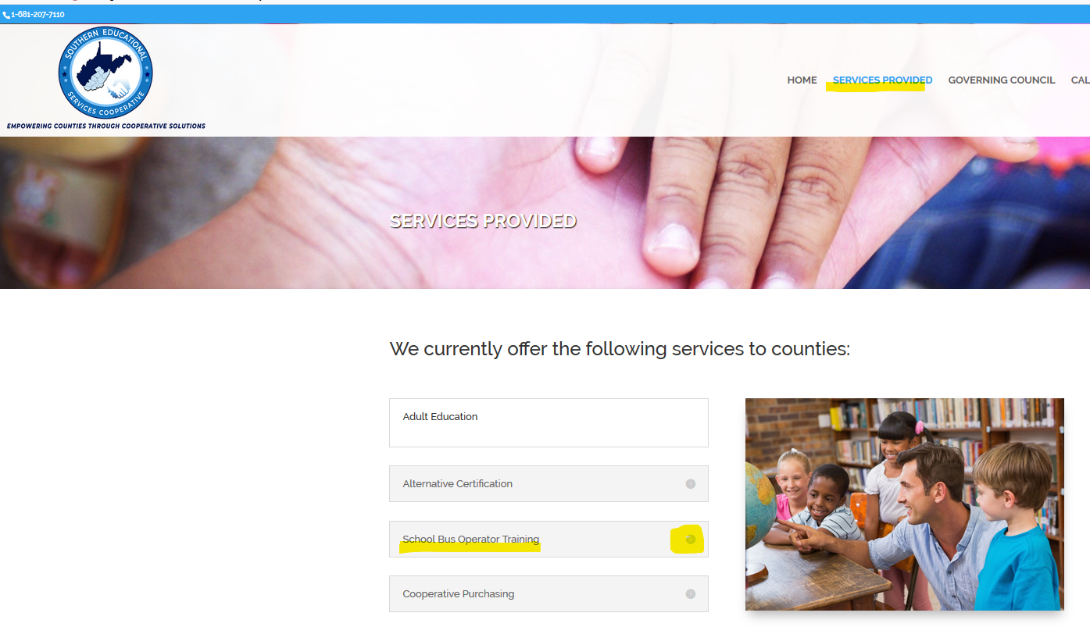
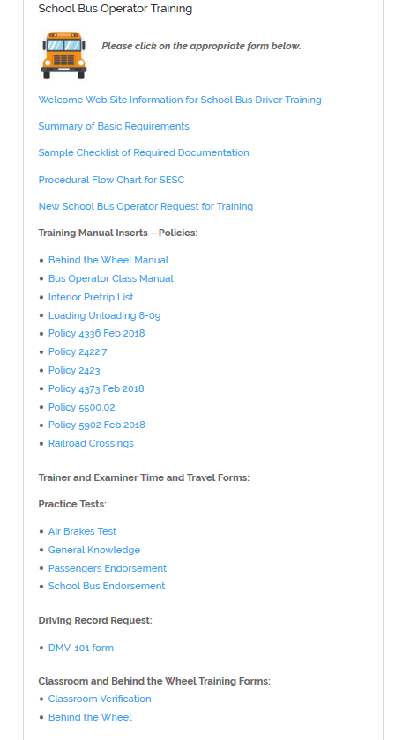
Southern Educational Services Cooperative www.sescwv.org

Slide 5
MISSION
The WVDE School Bus Operator Training Program is designed to provide certified, well trained, and highly qualified school bus operators for all counties throughout West Virginia by meeting all the requirements of the West Virginia Department of Education, the West Virginia Board of Education, and the State of West Virginia Department of Transportation.
Finally, the program will provide a thorough and efficient program of instruction, examination and certification of school bus operators.
PURPOSE
The purpose of the procedural manual that was provided to all trainers is to provide an efficient systematic approach to the entire certification process for new school bus operators.

Slide 6
31 Counties/Agencies Served by SESC
55 Trainers and 17 Examiners

Slide 7
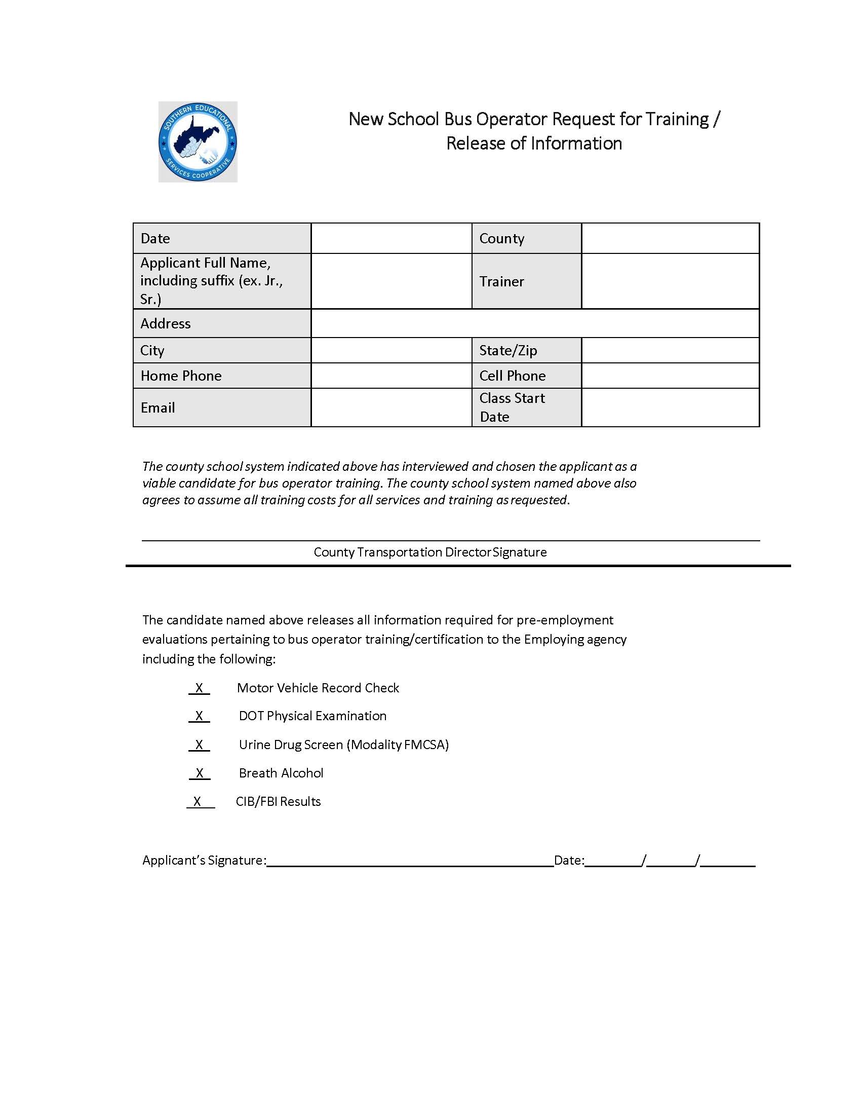
Request for Training Form
This form is the FIRST STEP in notifying our office that a class is beginning.
When completed with applicant information and transportation director’s signature, forward form to our office for entry in database.

Slide 8
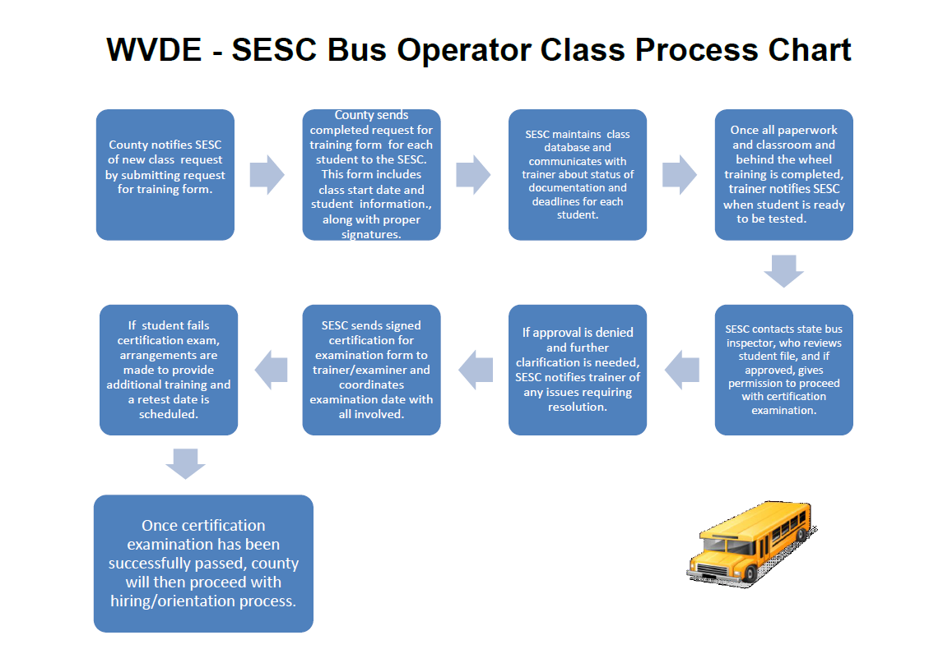

Slide 9
SESC Bus Operator Class Process Chart
This form includes class start date and student information, along with proper signatures.
SESC maintains class database and communicates with trainer about status of documentation and deadlines for each student.
Once all paperwork and classroom and behind the wheel training is completed, trainer notifies SESC when student is ready to be tested.
County notifies SESC of new class by submitting request for training form for each student.

Slide 10
If approval is denied and further clarification is needed, SESC notifies trainer of any issues requiring resolution.
SESC contacts state bus inspector, who reviews student file, and if approved, gives permission to proceed with certification examination..
SESC sends signed certification for examination form to trainer/examiner and coordinates examination date with all involved.
If student fails certification exam, arrangements are made to provide additional training and a retest date is scheduled.
Once certification examination has been successfully passed, county will then proceed with hiring/orientation process.
Notes:
When you are ready to begin a new class, complete the request for training form, with the signatures of the student and transportation director. This informs us that you are ready to start a class and we have the student’s permission to view sensitive information, such as the physical, drug test, etc. Send the completed forms to Paula or Charlie. We will enter class information in our database. As you receive paperwork, such as the physical, drug and alcohol test, etc., please forward to us. We will review and mark as received in our database. We will keep you informed by emailing an updated database showing check marked boxes beside documentation we have received, with unchecked boxes indicating what is still needed to complete the file.
Once all documentation is sent to our office and reviewed, we will forward to state bus inspector for final review. If no issues need to be clarified, the inspector will approve scheduling of examination. We will sign examination for certification form, inform trainer of recommended examiner(s), provide contact info if needed; and the trainer and examiner will schedule exam at a time convenient for all. Please keep our office informed of date, time and location of exam. After exam is complete, if student has passed, the examiner will send to our office the four-page completed documentation. If student failed, examiner will advise trainer of the recommended additional training that is needed, and an exam date will be rescheduled. Once student has passed certification exam, the SESC’s training process has concluded.

Slide 11
County Responsibilities
Select candidates
Provide facilities and equipment
Maintain file
Schedule physical, alcohol, drug tests, FBI, DMV records, CPR class
Complete request for training form
Provide copy of bus operator training manual
Set up date and time of classes
Submit all required paperwork to the SESC
Review and approve all payroll submitted by trainers
Provide payment to SESC for services
Submit training costs to WVDE for reimbursement
Notes:
Provide classroom, computer equipment, Smart Horizon log in info, provide bus for BTW training.
County keeps originals of all documentation.
Regarding payroll – we hope to adopt an online time sheet through Microsoft Forms and Flow process, whereby transportation director will approve trainer time sheet via email.

Slide 12
Applicant Responsibilities
  Apply and be interviewed at the county level
  Complete required forms:
    Form 7
    Form 126CSR99 (Application for Bus Operator Certification)
    DMV-101-PS2
Sign New School Bus Operator Request for Training form (Appendix A)
  Be available to obtain all required tests
  Report to all scheduled training sessions on time
  Pass WV Bus Operator Online Certification Exam
  Complete all required classroom and behind the wheel training
  Be available to schedule with trainer examination with the WV DMV CDL examiner
  Provide a copy of CDL to employing agency

Slide 13
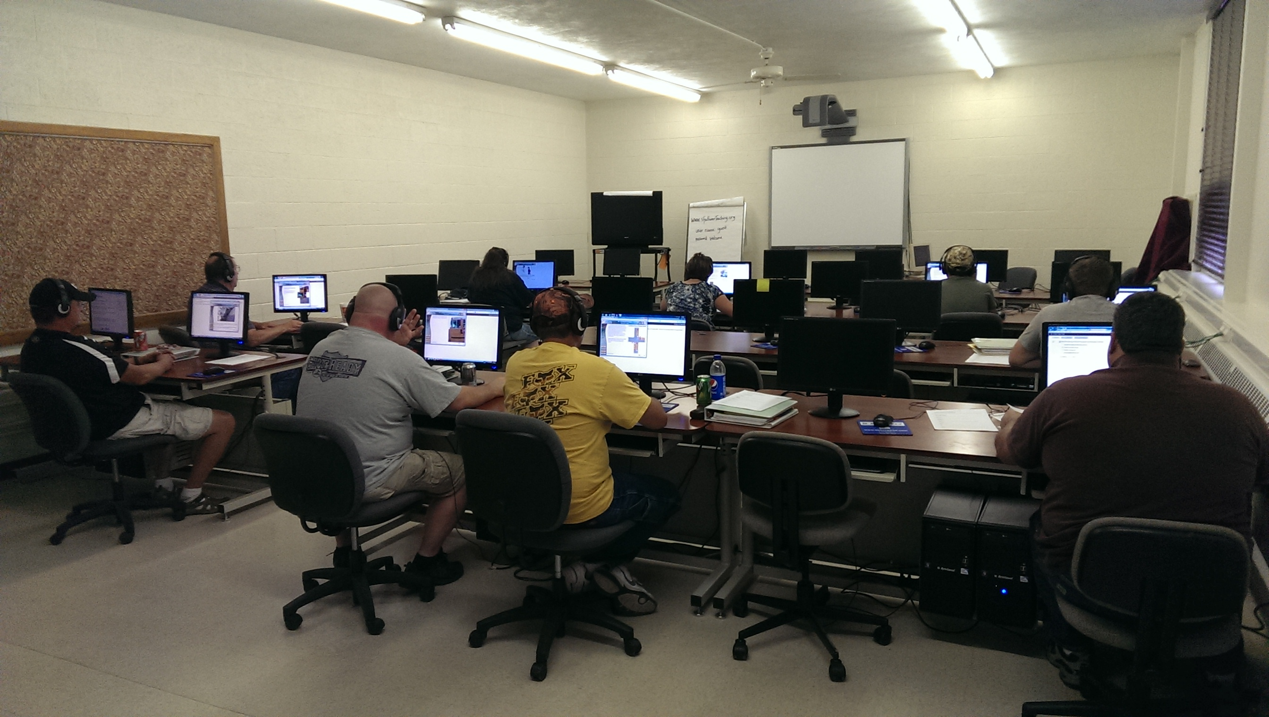
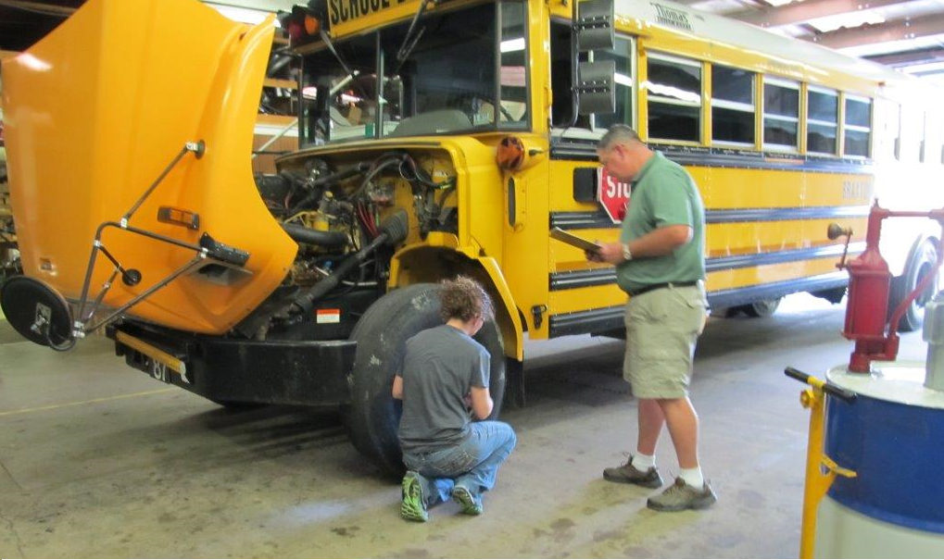
Trainer Responsibilities
Instruct the course
Complete a minimum of 40 hours of non-driving instruction and a minimum of 12 hours of behind the wheel training.
  Maintain current certifications and be available to conduct training expeditiously.
  Submit all documentation to SESC in a timely fashion.
  Schedule test with WV CDL examiner for trainee.
  Assist in scheduling
  certification examination.
Notes:
We have had a few trainees get certified in 24-28 days.
Raleigh County BOE is our fiscal agent, so we must abide by their time sheet submission deadlines, which they provide each month to us. We keep trainers apprised of deadlines, as well.

Slide 14
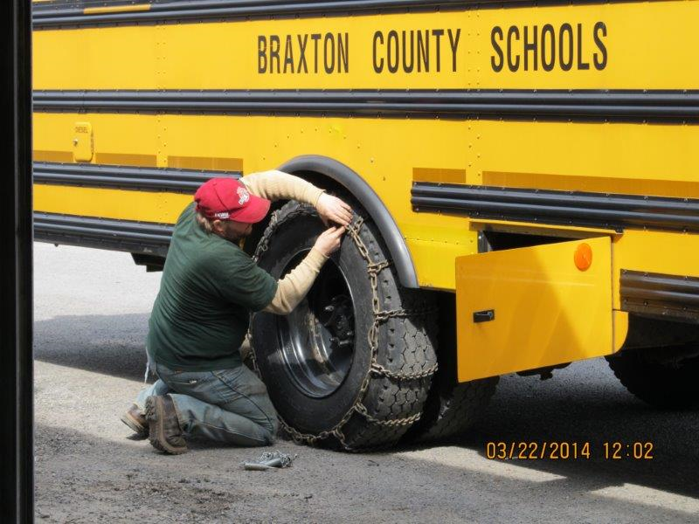
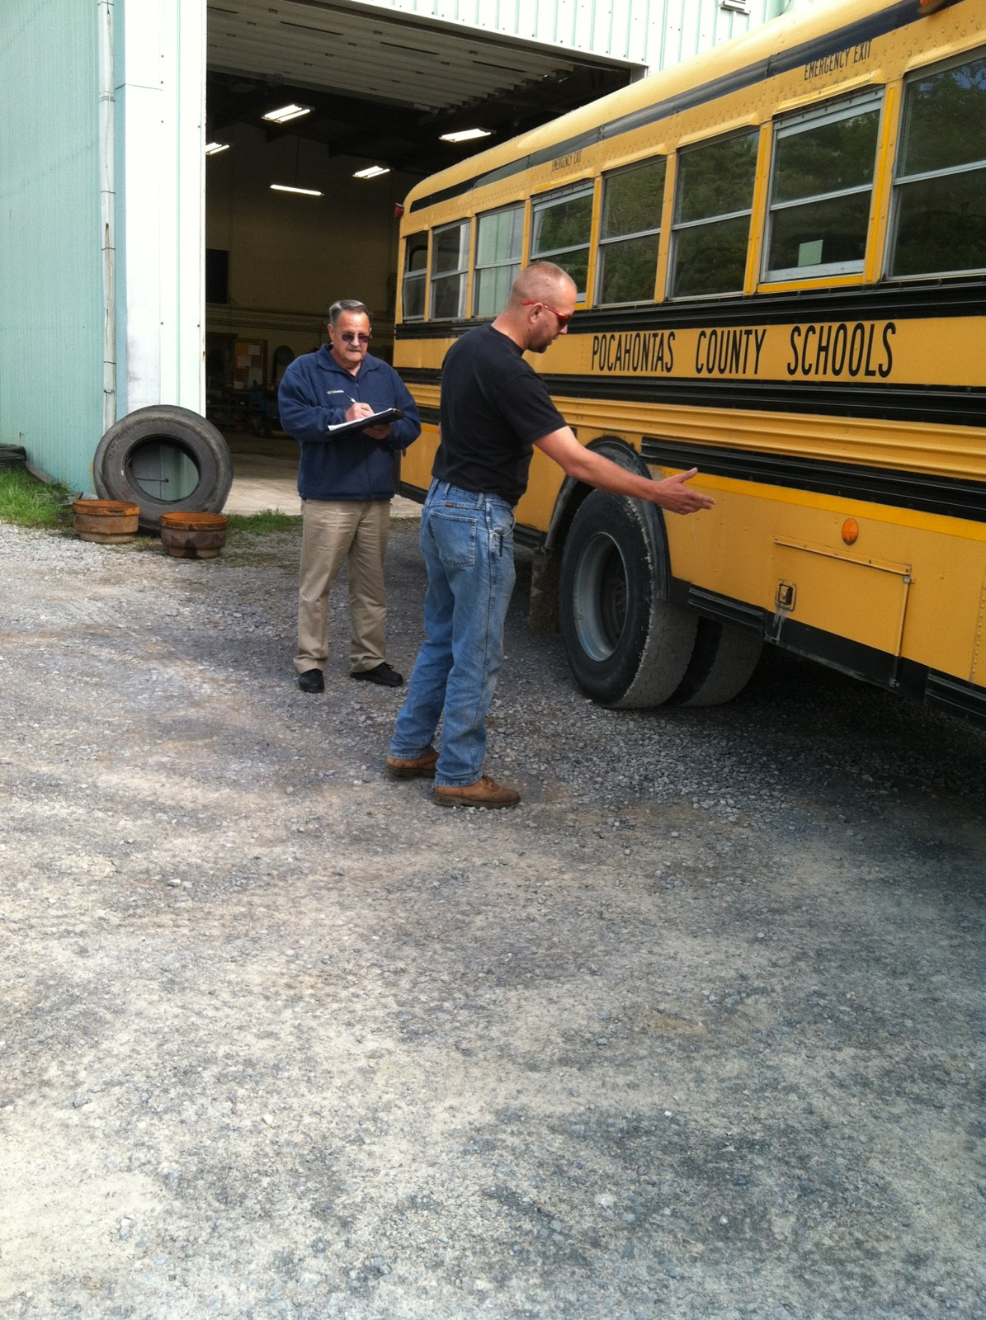
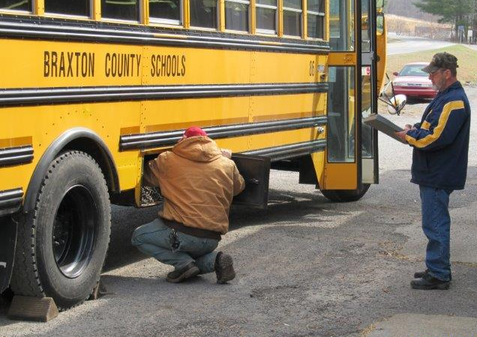
Examiner Responsibilities
  Maintain current certifications and be available for examinations
Conduct examinations per state procedure only after paperwork has been reviewed and approved by SESC and state inspector
It is not permissible for examiner to administer exam to:
    a trainee to whom he/she is related
    a trainee to whom he/she has provided training in preparation for the exam, or
    a trainee in the same county in which examiner works
  Submit time and travel forms to the SESC
  Complete required forms and submit to county transportation director/designees

Slide 15
WVDE Responsibilities
  Provide a liaison to coordinate the statewide training program – currently, Victor Gabriel
  Provide guidance per policy 4336 and the Manual of Procedures
  Certify trainers and examiners
  Provide results of criminal background checks to the county
  Certify school bus operators (issuing certification cards)
  Observe and monitor the program to ensure compliance
  Review all training documents electronically for approval, prior to any exam being administered
  Schedule periodic meetings with trainers, examiners and transportation directors to assure that all training is consistent
  Observe and monitor trainers and examiners to assure quality training and fair and consistent exams are administered

Slide 16
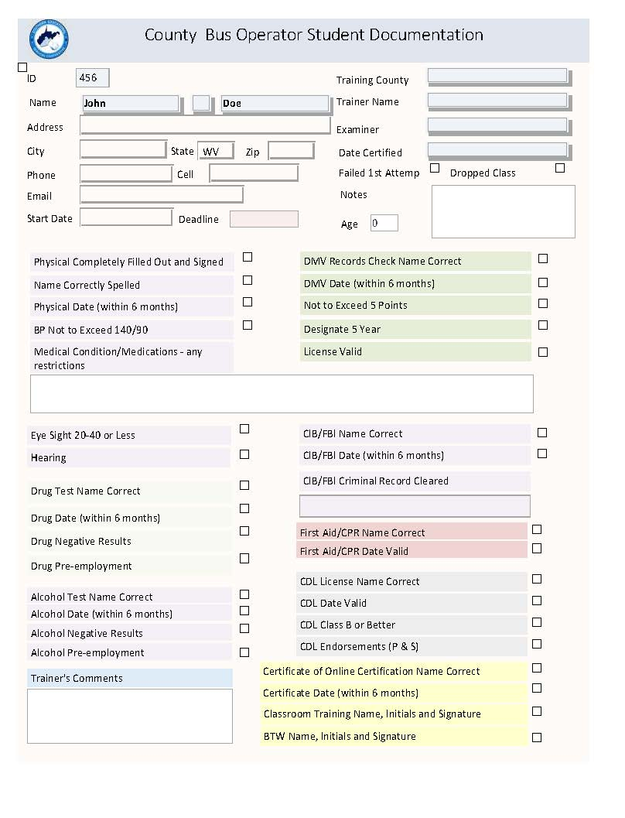
This database form is a checklist we use to track required documentation and periodically send to trainers to update them.
Checklist of Needed Documentation

Slide 17
Certification of School Bus Operator Check List
Physical must be checked for the Following
  Completely filled out and signed
  Date (not more than 6 months)
  Name (correct spelling)
  Blood Pressure (not to exceed140/90)
  Medical Condition(s)/Medication (s) (for restrictions)
  Eye Sight (must have 20-40 or better)
  Hearing (as described on the physical)
Drug Test
  Name (correct spelling)
  Date (not more than 6 months)
  Must reflect negative results
  Must state Pre-Employment
Alcohol Test
  Name (correct spelling)
  Date (not more than 6 months)
  Must reflect negative results
  Must state Pre-Employment
DMV Records Check
  Name (correct spelling)
  Date (not more than 6 months)
  Not to exceed 5 points
  Must designate a 3 year (verify by issue date)
  License must be valid
CIB/FBI
  Name (correct Spelling)
  Date (not more than 6 months)
  Any criminal record disclosed must be cleared by the DEPT. Of ED.
  (Before the test can be administered.)
First/CPR
  Name (correct spelling)
  Date must be valid
Copy of CDL Licenses
  Name (correct spelling)
  Date (must be valid)
  Class (B or Better)
  Endorsements (P & S)
Certificate of completion of online certification
  Name (correct spelling)
  Correct date (not more than 6 months)
Forms verifying all required training time (Class room/Behind the wheel)
  Name (spelled correctly)
  Initials and signature (Applicant & Trainer)
Certification Form (yellow)
  Required signatures

Slide 18
Documentation We Do NOT Need
High school diploma or transcripts
Letter of explanation of criminal background disclosure – this is sent to Sherry Sadler’s office, WVDE
Certificates of each online module – we need only the certification test certificate
Form 7 and Bus Driver Application – these are sent to Sherry Sadler, WVDE

Slide 19
Certification for Examination Form: final steps in certification process
Once all documentation is sent to our office and reviewed, we will forward to state bus inspector for final review. If no issues need to be clarified, the inspector will approve scheduling of examination by our office.
We will contact next examiner in the rotation list, and provide the trainer with contact information.
If failure occurs, recommended training will be provided, and a retest date will be scheduled with same examiner.
Notes:
We will sign examination for certification form, inform trainer of recommended examiner(s), provide contact info if needed; and the trainer and examiner will schedule exam at a time convenient for all. Please keep our office informed of date, time and location of exam. After exam is complete, if student has passed, the examiner will send to our office the four-page completed documentation. If student failed, examiner will advise trainer of the recommended additional training that is needed, and an exam date will be rescheduled, after refresher training has been provided. Once student has passed certification exam, the SESC’s training process has concluded, and the county can initiate hiring procedure.

Slide 20
SESC’s FY19 Statistics
 | FY | # Enrolled | # Certified
RESA 4 | 2012 | 51 | 18
 | 2013 | 71 | 38
 | 2014 | 79 | 41
 | 2015 | 61 | 27
 | 2016 | 100 | 39
 | 2017 | 68 | 37
 | 2018 | 59 | 29
Total |  | 489 | 229
SESC | 2019 | 427 | 181
Trainees Enrolled: 427
Certified Drivers: 181
Trainees Dropped: 172
Average Training Days: 60
Notes:
REASONS FOR DROPOUT
Cannot pass drug and/or alcohol test
Work schedule does not permit class and behind the wheel time
Failure to complete/pass CDL
Physical exam requirements
FBI criminal background check disclosure
Lack of communication with trainer
Please notify us when a trainee officially drops out of class.

Slide 21
Inspectors’
Assignments
Dave Moore
Darrin Younker
Ray Dickens
Dave Baber
Wes Stone

Slide 22
Important Websites and Contact Numbers
SESC – sescwv.org
FMCSA National Registry - fmcsa.dot.gov/regulations/medical/national-registry
WVDE policies - wvde.state.wv.us/policies/
WVAPT - wvapt.org/
Paula Hamilton - pdhamilt@wvesc.org
Charles Phillips - charles.phillips@wvesc.org
SESC Telephone - 304-872-6440 or 6441, Fax - 304-872-6442

Slide 23

Frequently Asked Questions
Can I choose my examiner?
How many exams can be scheduled in one day?
What if B/P is over 140/90?
Can a diabetic enroll in class?
What if trainee has a pacemaker?
Notes:
The SESC assigns the examiner on an equitable rotation basis.
Realistically, two or three per day, per trainer. Multiple trainers can administer exam for more students at the same site simultaneously, if needed.
17.3.8. Blood pressure is less than or equal to 140 systolic and 90 diastolic (140/90). If the employee fails the blood pressure test, the trainee shall provide medical evidence of three separate blood pressure readings equal to or below the identified levels on three different days within a seven (7) day period prior to certification. These readings shall be certified by a Medical Examiner. Can be attending physician at medical facility, office of physician who gave physical, or school nurse. Should be on physician’s office letterhead or prescription pad.
If trainee is a diabetic and on insulin shots or pump, he cannot drive a school bus. Insulin pills are permissible. If a trainee is a current employee and then has to be put on insulin, he is eligible to drive if he gets a waiver – applies only to intrastate (in state only).
5. When a school bus operator trainee is required to use a pacemaker, his participation in program shall be approved by two cardiologists not affiliated with each other.

Slide 24
FAQ – continued….
What must county do if FBI check discloses a criminal finding?
What happens if trainee fails certification exam on the initial attempt? How long does he need to wait before re-testing?
If trainee has a suffix on name, what needs to happen on all paperwork?
What if trainee already has a current CPR/1st Aid card?
Do both the alcohol screening and drug test need to have DOT or FMCSA on form?
Notes:
A letter of explanation must be submitted to Sherry Sadler’s office, and a determination will be made via email if applicant can proceed to training/certification.
Examiner will inform trainer of area(s) of failure, additional training will be given and documented, and a re-test can take place after a minimum of five days after initial exam.
Name suffixes, such as Jr., Sr., I, II, etc. must be on all paperwork.
If CPR class is done as classroom training, it counts as 6 hours. Best practice is to have CPR as a class. The first aid/CPR must be a valid card. If not, 6 additional hours of relevant training from some other resource must be provided. Some additional training suggestions could include defensive driving, CDL training, etc.
We have recently been advised that alcohol testing is not required by the DOT, but only by WVDE Policy 4336. As we understand it, the FMCSA does not want their agency name associated with alcohol testing for our program. Therefore, you may want to discuss this with the testing facility; specifically, under Remarks on the Alcohol Test form, please do not use the phrase DOT/FMCSA or check any boxes indicating that this is a test for the DOT/FMSCA.

Slide 25
FAQ – continued….
If DMV record does not have a five year look back, what needs to occur?
What are the age and driving requirements to be accepted into training program?
What needs to occur when a drug screen indicates “Dilute”?
What needs to occur if trainee has a diagnosis of sleep apnea on physical?
Notes:
Report must reflect last five (5) years of driving record with the exception of an applicant that has less than five (5) years of driving experience. If applicant has resided in multiple states in the last 5 years, county will have to obtain DMV driving records from each state. (The “request for driving records” form can be found as Appendix E of Policy 4336).
Applicant must be 21 years of age with a minimum of three (3) years of driving experience.
A dilute negative is a grounds for a re-test, but a dilute positive is considered a positive test, as well as refusal. Trainee is dropped from class.
If using CPAP – we must have attending physician's letter showing compliance or CPAP readings. 15. 17.4. All bus operators using CPAP devices must meet the requirements of FMCSA. 17.4.4. Compliance is defined as using PAP for the duration of total sleep time, or as prescribed by the treating provider. It is the bus operator’s responsibility to keep a log of his/her compliance and provide documentation to the county on a quarterly basis. Counties shall maintain all such records.

Slide 26
FAQ – continued….
Does a trainee need to know how to drive every bus in the fleet?
Can a driver transfer from one county to another?
Who gets the Form 7 and bus operator application?
After trainee is certified, who is responsible for sending copy of four-page exam paperwork to us so that we can close file? (Certification, Pre-trip, Phys. Performance and BTW)
What is the maximum number of points allowed on DMV record?
Notes:
Yes
As long as everything is current – contact WVDE – initial county retains certification. Ask WVDE to change home county. Original county needs to release info. It is recommended that the county provide six hours BTW training. If transit bus is used – make sure driver is/was certified using transit.
Sherry Sadler’s office.
Examiner.
Applicant can have no more than 5 points on their DMV driving record. If a prospective student has 6 points or more on driver’s license, he can technically begin bus driver class, but needs to be enrolled in and pass a defensive driving class, and have points (up to 3 points) taken off his record before being certified as a bus driver.

Slide 27
FAQ – continued….
If a trainee is hired by the county after being certified, and wants to drive in the coming school year, his physical needs to be dated after what month?
Can a trainee have monocular vision and drive?
What happens when a DUI is disclosed on DMV record?
Do all fields on a physical need to be completed?
Notes:
April
No. Monocular vision is vision in which both eyes are used separately. By using the eyes in this way, as opposed to binocular vision, the field of view is increased, while depth perception is limited.
If convicted of DUI, you lose your license for at least 24 months, so trainee would not be eligible to be a school bus operator for at least two years. If a trainee has a DUI on his DMV record, send a letter of explanation to Tommy Young’s office (Sherry Sadler) – can be brief and handwritten – to get permission to proceed with training/certification. As far as hiring someone with a DUI conviction, the first offense is left up to the county as to if or when they hire that person. A second offense conviction of DUI by policy disqualifies a person permanently. Some counties will not hire anyone who has a DUI on records. Other counties will have a five year lapse. Check with Sherry Sadler’s office to see if on county application box 6 is checked NO, does the applicant complete new application in which he marks the box 6 as YES.
Yes, each field must be completed. Fields commonly left blank are:
Page 1 – Driver ID Verified by and completed list of medications
Page 3 – Horizontal Field of Vision Degrees and Hearing Test Results
Page 4 – Bubble for meets standards for what amount of time

Slide 28
Evaluation form
Please complete and turn in to us at end of session.

